Slide 1



India’s First Aadhaar Based Social Marketplace
Aadhaar Hackathon 6 -7 June 2015

Slide 2
SamAadhaar - Overview
Products and
Services
Providers
Mitr (Local Partner)
Government
Agricultural Commodities and tools
Commercial Shops like Kiryana shops
Financial institutions
SamAadhaar
(Aadhaar based Social Marketplace)
Financial Products
Commercial Enterprises
Grahak
(Customer)
Self Help Groups
Self Help Groups
NGOs
Health Products and Schemes
NGOs
Local Government
Government Schemes
Health Institutions
NGO outreach
Education Institutions

Slide 3
How do we use Aadhar API’s in our full life cycle
Authenticate
Identify
Personalize & Localise
Transact
Delivery & Monitoring
Auth KYC
A user logs into the application by authenticating via auth KYC using Biometric or OTP
Auth KYC
User KYC info is loaded into the application session as part of Auth KYC
Smart Filters
Based on the user KYC info and service history, smart filters are applied to make it a personalized & localized experience
Auth Bio metric/OTP
Bio Metric/OTP
User orders a product/service and we use Aadhar Auth Biometric/ OTP as a digital signature to confirm the transaction as well as the final agreement.
When the Product/Service is delivered to the customer, we monitor and confirm that it has reached the bonafide person via Aadhaar

Slide 4
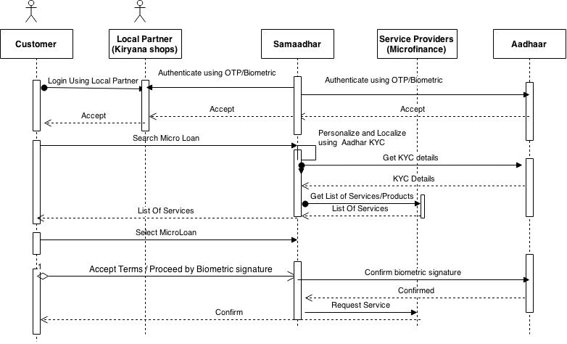
Enabling Micro Finance using SamAadhaar

Slide 5
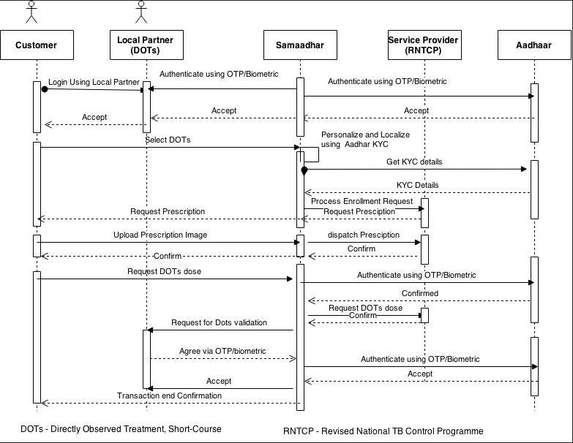
Enrolling and Monitoring DOTs using SamAadhaar

Slide 6
Samaadhar is an Aadhaar based Social Marketplace connecting internet disabled people to Product and Service Providers via local Partnerships
Uses Aadhaar for authenticating the user, targeting the customer segment, personalizing and localizing experience for the customer, service agreement using digital signatures and ensuring delivery to bonafide customer
Samaadhar can evolve into an information broadcast platform leveraging local partnerships to bridge the information barrier.

